Slide 1
Networking Basics For Applications

Slide 2
Agenda
Outline the OSI model
Addressing
Implement IPv4 addressing
Understand network structures
Discuss private networks and NAT translation
Multiplexing
Port numbers and application management
(Light MATH warning)
🚨 🚨

Slide 3
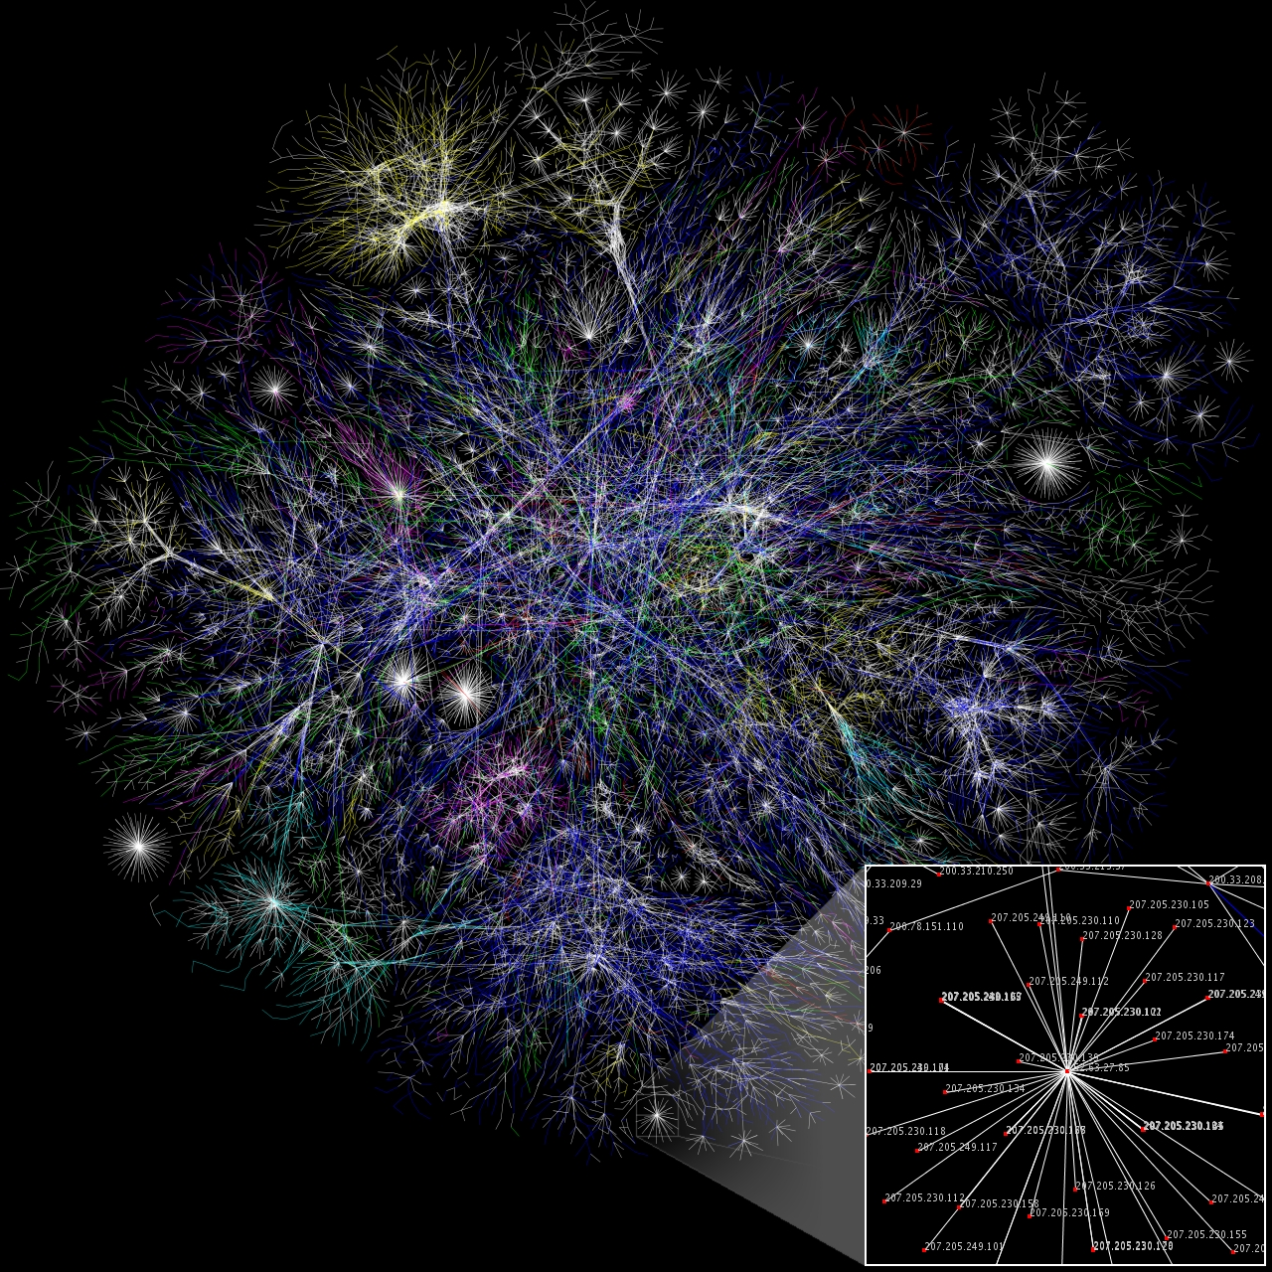
Networking
Devices are more useful when they can talk to other devices (citation needed)
Very first connection → 1940
Fledgling networks through 1960s-70s
ARPANET / ALOHA
Internetworks in late 70s
Research & commercial adoption
Today, billions of devices connected across billions of separate networks
Notes:
https://en.wikipedia.org/wiki/Computer_network#/media/File:Internet_map_1024.jpg

Slide 4
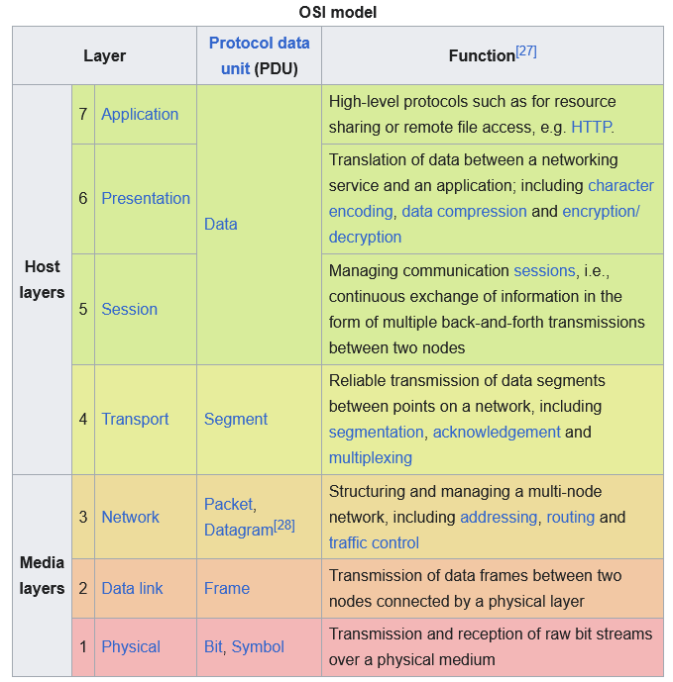
OSI model
Computer networks are complex
Desire to exchange network services based on needs
Latency
Bandwidth
Reliability
Mobility
→ Separate functionality / roles into layers
Base concerns for application developers
Multiplexing
Addressing
Reliability
Other layers important for troubleshooting issues
Notes:
https://en.wikipedia.org/wiki/OSI_model

Slide 5
A Brief Aside: Protocols
Ever interact with a protocol officer?
Protocols inform developers how to communicate
TTPs for software
MUST, MUST NOT, SHOULD, SHOULD NOT
Data types, formatting, extensibility
Common protocols
Ethernet
IP
TCP
UDP
TLS/SSL
HTTP
SMTP
FTP

Slide 6
IPv4 Addressing

Slide 7
IPv4 Addressing Basics
Addresses
4 octets of 8 binary digits (bits) → 32 bits
Expressed in dotted decimal notation
192.168.0.1
11000000 10101000 00000000 00000001
Range of each octet is 0 – 255
A logical identifier for a device
Each device can have multiple addresses
In principle, each identifier is unique
Networks
Logical separation of address spaces
Devices on the same network can talk directly (switched)
Devices on separate networks need to be routed
Networks are defined by a “mask”
The first N bits define the network portion
The remaining 32 - N bits define the device ID
192.168.0.1 /24
24 bits → network mask, last 8 bits → device mask
11000000 10101000 00000000 00000001
192.168.0.1 /24

Slide 8
Binary Refresher
1 byte = 8 bits
Range = 0 – 255
Commonly the Most Significant Bit is on the left
Add up any value that has a `1` below it
128 64 32 16 8 4 2 1
0 1 1 0 0 0 0 0 (binary)
64 + 32 = 96 (decimal)
32 bits = ?
4,294,967,295 max

Slide 9
IPv4 Addressing – More Networks
Work through some samples
172. 20. 10. 5 /14
10101100 00010100 00001010 00000101 (IP address)
11111111 11111100 00000000 00000000 (network mask)
10101100 00010100 00000000 00000000 (network addy)
172.20.0.0
00000000 00000011 11111111 11111111 (device mask)
10101100 00010100 00001010 00000101 (device addy)
172.20.10.5
10. 12. 45.100 /16
190.154. 10. 1 /12
190.154. 30. 50 /12
10. 65. 1. 20 /16
172. 22. 5. 9 /14
Which addresses are on the same network?
How many devices addresses can be assigned in a /16?
Called “Classless InterDomain Routing” (CIDR)
Early internet was divided into “classes” of networks
/8
/12
/16
CIDR enables more efficient subnetting
190.154. 10. 1 /12
190.154. 30. 50 /12
172. 22. 5. 9 /14
172. 20. 10. 5 /14
10. 12. 45.100 /16
10. 65. 1. 20 /16
Notes:
Given a host address, determine network address
Convert to binary
Apply network mask
Convert to dotted decimal

Slide 10
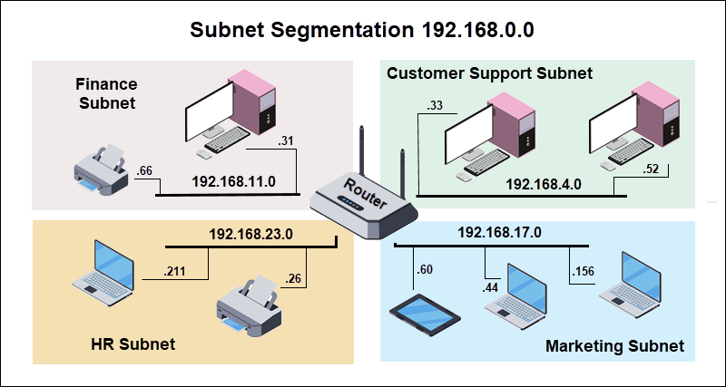
Notes:
Subnetting allows us to split one larger network into multiple, smaller networks.

Slide 11
IPv4 Addressing – Reserved Addresses
Network Range | Purpose
0.0.0.0/8 | Network identification, default routes
10.0.0.0/8 | Private networks (RFC 1918)
100.64.0.0/10 | Carrier-grade NAT (CGNAT)
127.0.0.0/8 | Loopback (localhost)
169.254.0.0/16 | Link-local (APIPA)
172.16.0.0/12 | Private networks (RFC 1918)
192.0.0.0/24 | IETF Protocol Assignments
192.168.0.0/16 | Private networks (RFC 1918)
192.88.99.0/24 | IPv6-to-IPv4 relay (deprecated)
198.18.0.0/15 | Network benchmark testing
224.0.0.0/4 | Multicast addresses
240.0.0.0/4 | Reserved for future use
255.255.255.255 | Limited broadcast

Slide 12
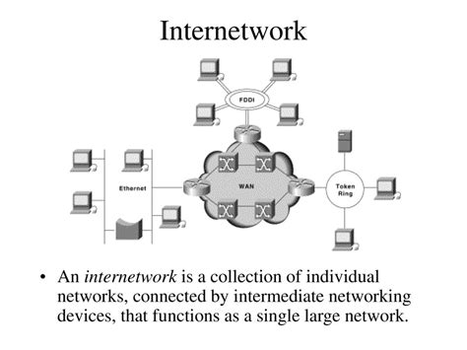
IPv4 Addressing – Even More Networks
Different networks → needs routing
Internet consists of a “network of networks”
How do I prevent people from talking to devices on my network?
Didn’t we run out of IPv4 addresses?
Aren’t IP addresses expensive?

Slide 13
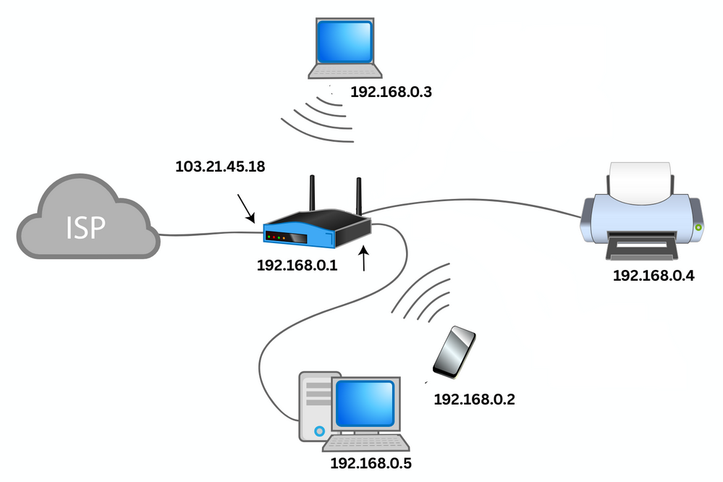
IPv4 Addressing – NAT
To address some of these concerns, translation was introduced
Usually the function of a router
Convert external IP address into internal IP addresses
Types
Static
Dynamic
PAT (NAT overload)

Slide 14
Multiplexing

Slide 15
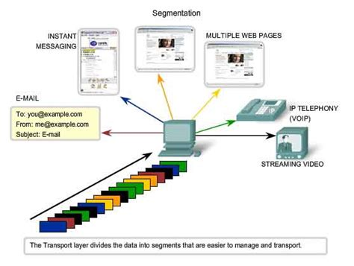
Multiplexing
“having many folds; many times as great in number; of many parts”
Fitting multiple streams over the same channel
Transport layer handles this with ports (sits above network layer)
Each socket consists of an IP/port pair between sender and receiver
Multiple streams of data on same interface
Operating system needs to know where (which application) traffic should go

Slide 16
Sockets
Scenario | Application | Source IP | Source Port | Dest IP | Dest Port | Socket Identifier (minus protocol)
Same App, Multiple Connections | Chrome (Tab 1) | 192.168.1.10 | 49152 | 142.250.185.46 | 443 | 192.168.1.10:49152 ↔ 142.250.185.46:443
 | Chrome (Tab 2) | 192.168.1.10 | 49153 | 142.250.185.46 | 443 | 192.168.1.10:49153 ↔ 142.250.185.46:443
Different Protocols | DNS Query | 192.168.1.10 | 51234 | 8.8.8.8 | 53 | 192.168.1.10:51234 ↔ 8.8.8.8:53
 | HTTPS Request | 192.168.1.10 | 51235 | 8.8.8.8 | 443 | 192.168.1.10:51235 ↔ 8.8.8.8:443
Same Dest Port, Different Services | Web Browser | 192.168.1.10 | 52001 | 93.184.216.34 | 80 | 192.168.1.10:52001 ↔ 93.184.216.34:80
 | FTP Client | 192.168.1.10 | 52002 | 93.184.216.34 | 21 | 192.168.1.10:52002 ↔ 93.184.216.34:21
Multiple Receivers | Email Client | 192.168.1.10 | 53001 | 74.125.200.108 | 993 | 192.168.1.10:53001 ↔ 74.125.200.108:993
 | Video Stream | 192.168.1.10 | 53002 | 151.101.1.140 | 443 | 192.168.1.10:53002 ↔ 151.101.1.140:443

Slide 17
Port Reservations
When developing an application…
Reserve an interface:port from the OS
Connect to some other interface:port
Use that socket to communicate
Every separate data stream needs its own socket (in general)
Different app
Different source
Different destination
Often handled by lower-level libraries
Cannot open a socket that another app is using
Python/powershell port demo

Slide 18
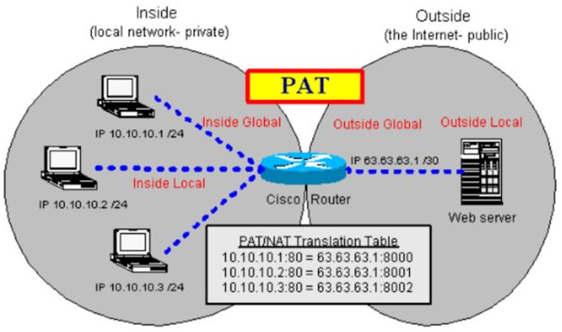
IPv4 Addressing – PAT
Back to networking…

Slide 19
PAT
Source IP | Source Port | Dest IP | Dest Port | Socket Identifier (minus protocol) | After PAT Rewrite
192.168.1.10 | 49152 | 142.250.185.46 | 443 | 192.168.1.10:49152 ↔ 142.250.185.46:443 | 203.0.113.50:50002 ↔ 142.250.185.46:443
192.168.1.10 | 49153 | 142.250.185.46 | 443 | 192.168.1.10:49153 ↔ 142.250.185.46:443 | 203.0.113.50:50003 ↔ 142.250.185.46:443
192.168.1.10 | 51234 | 8.8.8.8 | 53 | 192.168.1.10:51234 ↔ 8.8.8.8:53 | 203.0.113.50:50004 ↔ 8.8.8.8:53
192.168.1.10 | 51235 | 8.8.8.8 | 443 | 192.168.1.10:51235 ↔ 8.8.8.8:443 | 203.0.113.50:50005 ↔ 8.8.8.8:443
192.168.1.20 | 52001 | 93.184.216.34 | 80 | 192.168.1.20:52001 ↔ 93.184.216.34:80 | 203.0.113.50:50006 ↔ 93.184.216.34:80
192.168.1.20 | 52002 | 93.184.216.34 | 21 | 192.168.1.20:52002 ↔ 93.184.216.34:21 | 203.0.113.50:50007 ↔ 93.184.216.34:21
192.168.1.20 | 53001 | 74.125.200.108 | 993 | 192.168.1.20:53001 ↔ 74.125.200.108:993 | 203.0.113.50:50008 ↔ 74.125.200.108:993
192.168.1.20 | 53002 | 151.101.1.140 | 443 | 192.168.1.20:53002 ↔ 151.101.1.140:443 | 203.0.113.50:50009 ↔ 151.101.1.140:443
Notes:
In the cloud lessons, you’ll see how crazy the port mappings can get.

Slide 20
Questions

